Slide 1
The Escape
Group 3 presentation

Slide 2
Story overview
There once was a Robot who woke up and found himself stuck in a strange futuristic science lab filled with glowing , high-tech equipment with lots of obstacles and laser beams. It scans the room for an exit and spots a small opening in the wall. But who locked him there? Will he try to escape? Will he succeed?

Slide 3
TABLE OF CONTENTS
01
02
03
04
05
06
Concept art
Environment
Sketches and storyboard
Modeling and props
Texturing and UV unwrapping
Animation
Animating the character and camera movement
Compositing and lighting
character rigging

Slide 4
01
Concept art
By Ashraqat shahin

Slide 5
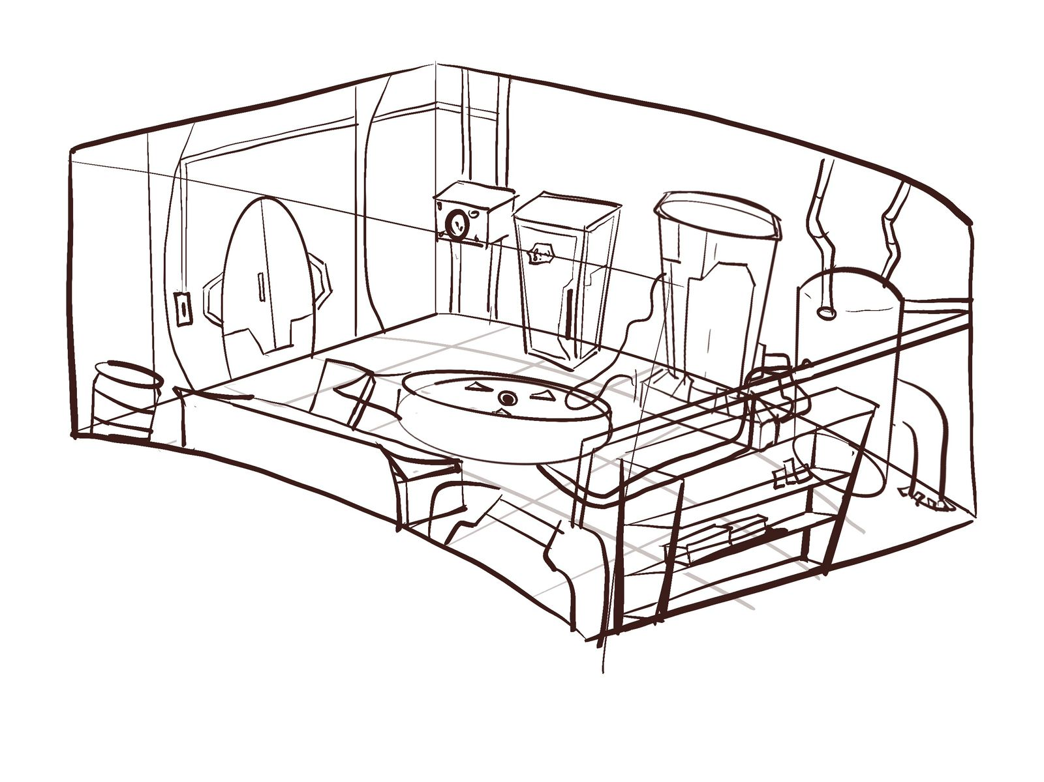
Environment
Futuristic science lab with different props and devices

Slide 6
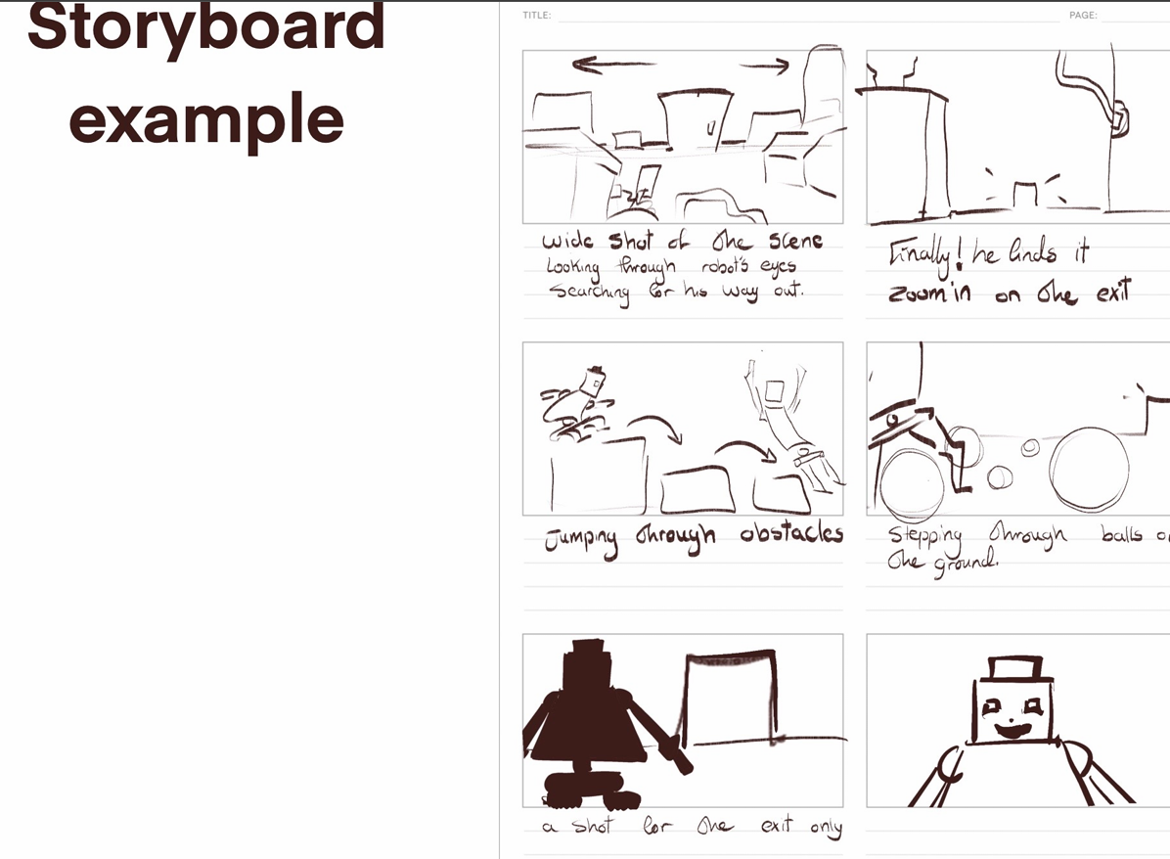

Slide 7
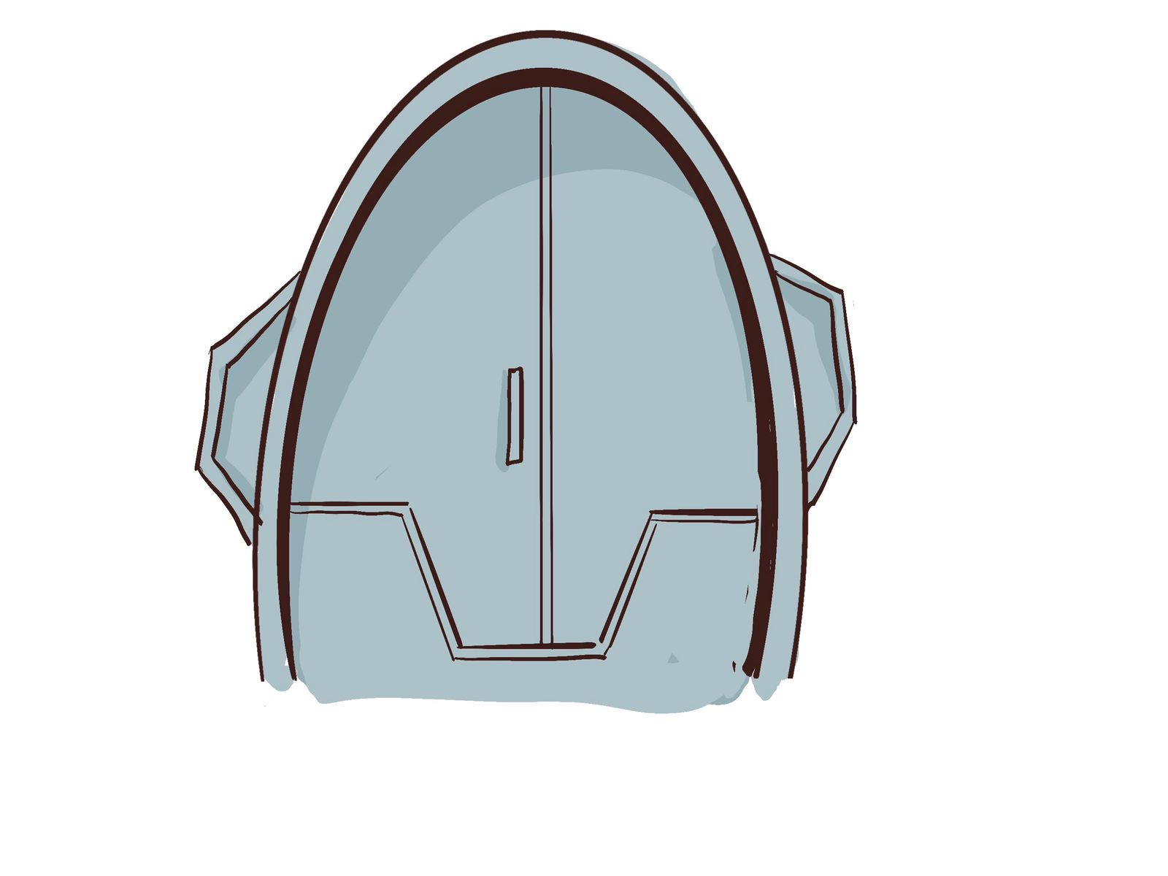
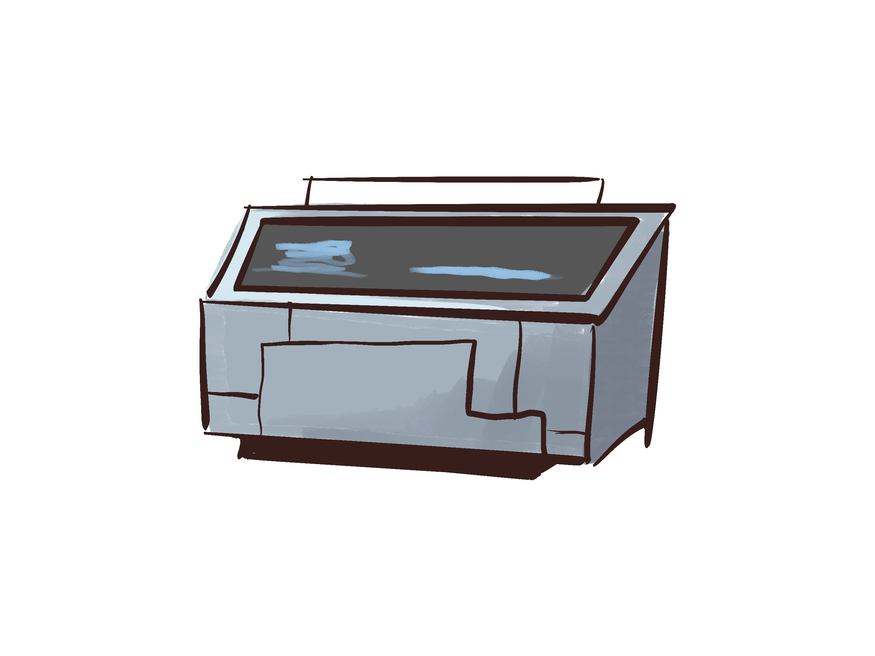
props
Statistics Display
door

Slide 8
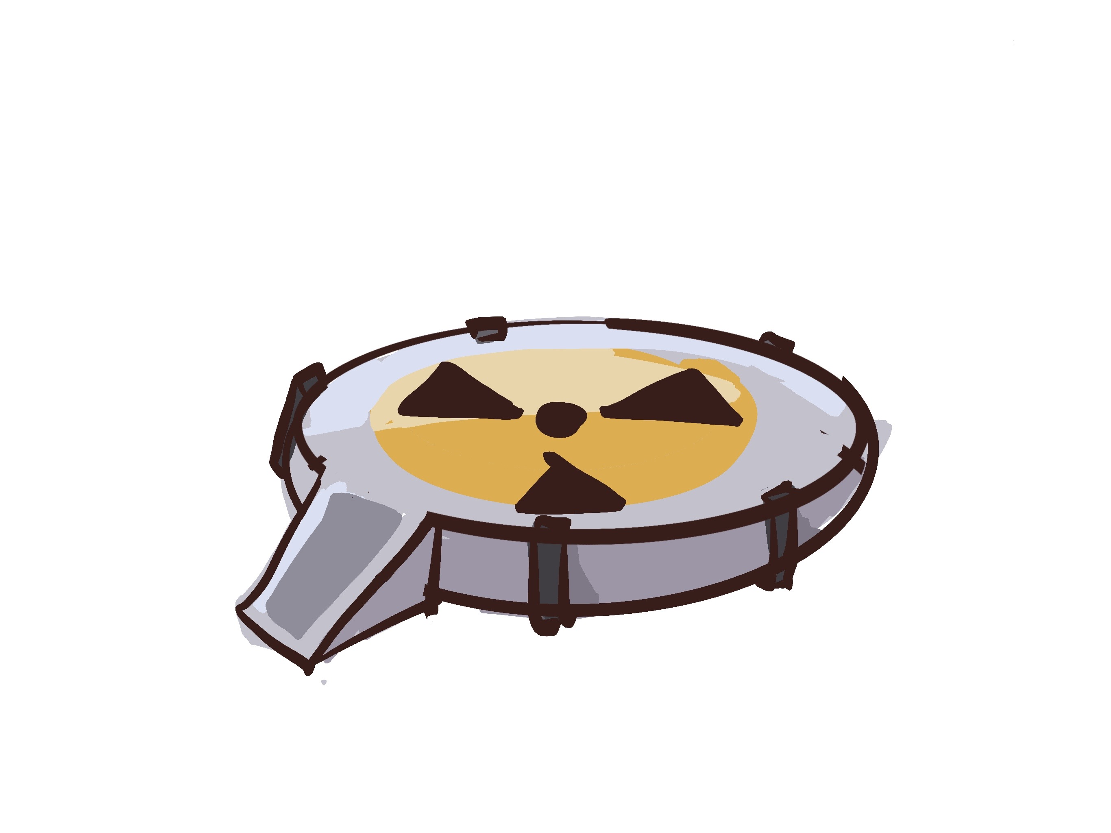
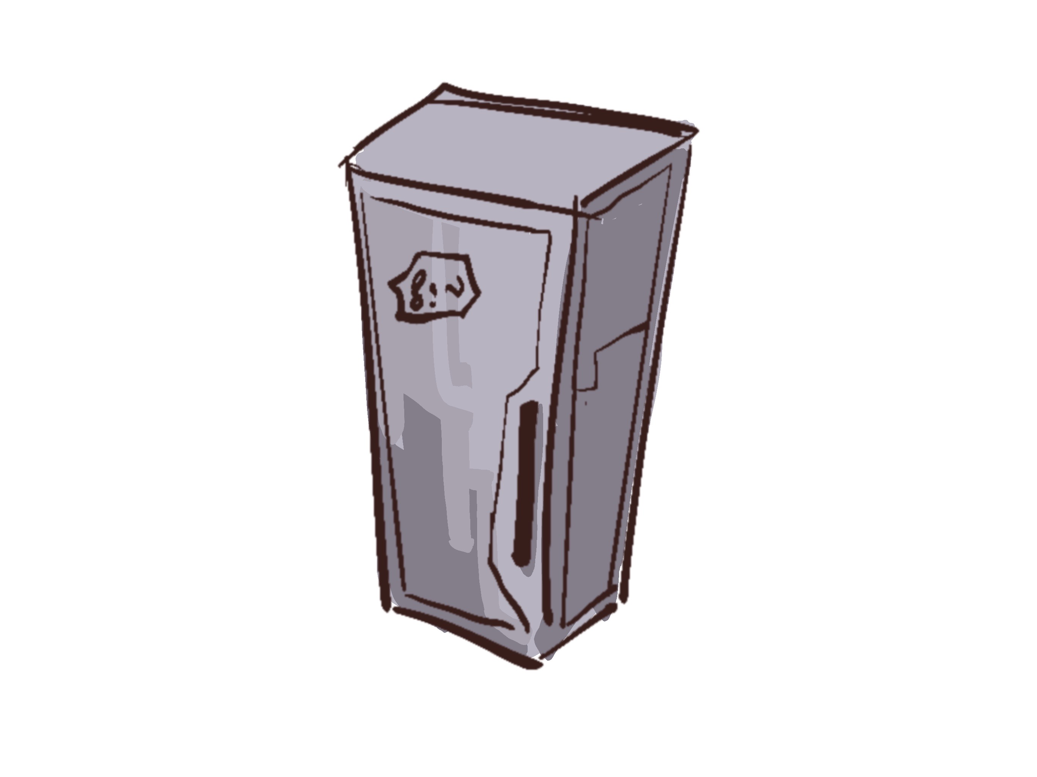
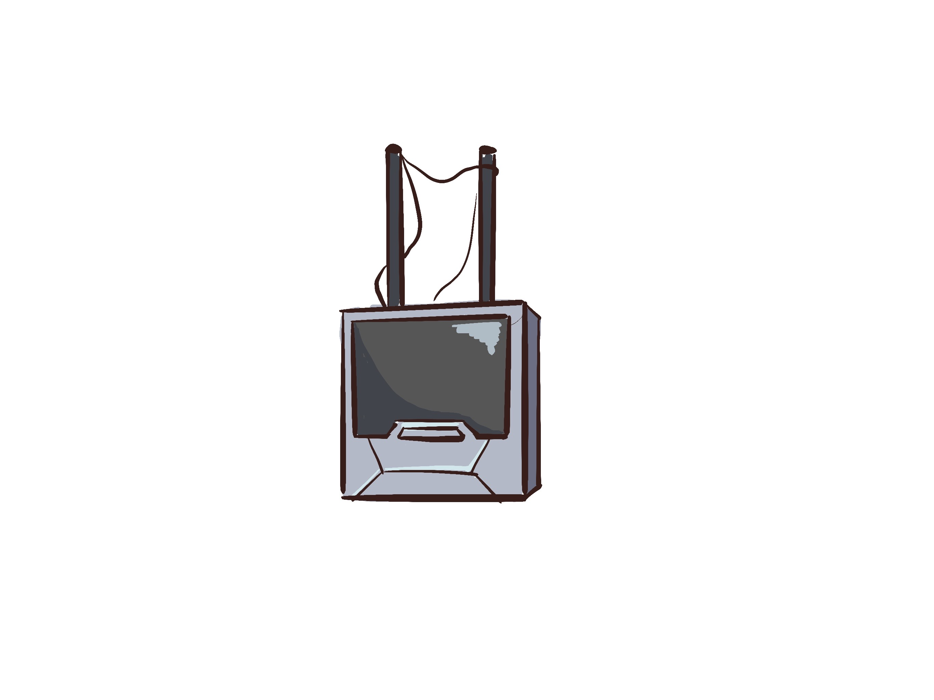
props
Nuclear
reactor
locker
radio

Slide 9
02
Environment
By Ashraqat shahin / Ehab Heness / Hana Mahmoud

Slide 10
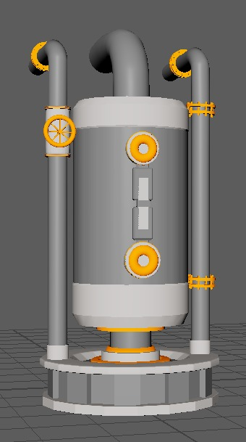
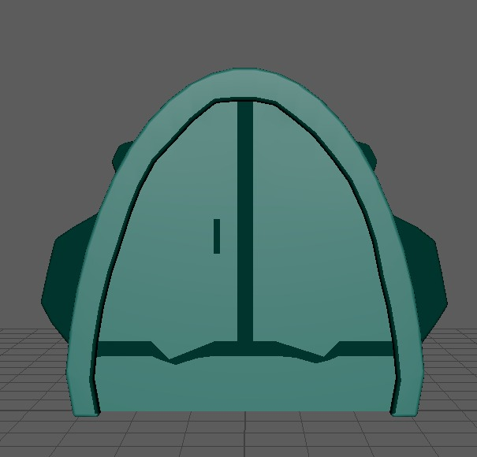
props
Hana Mahmoud

Slide 11
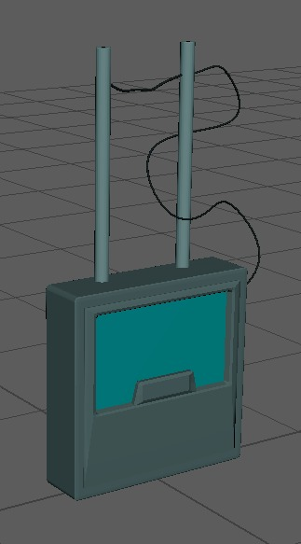
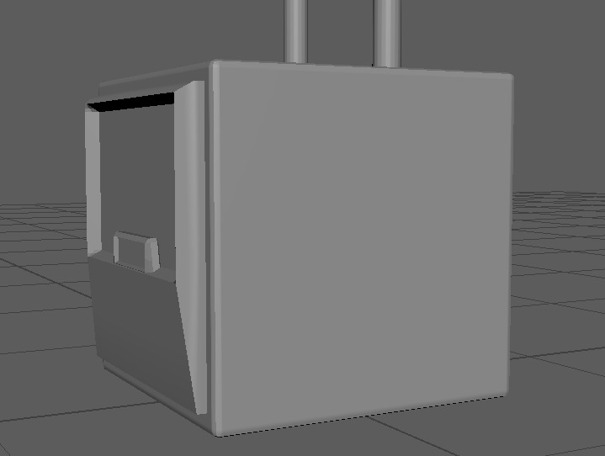
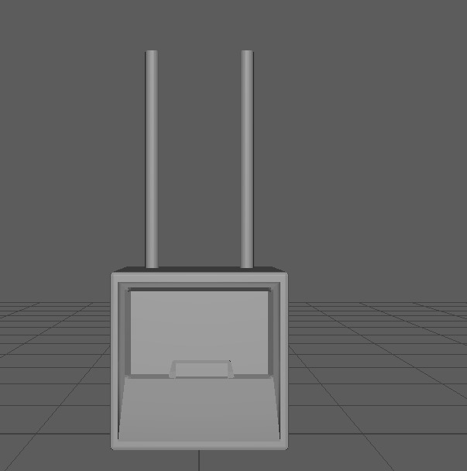
props
Hana Mahmoud

Slide 12
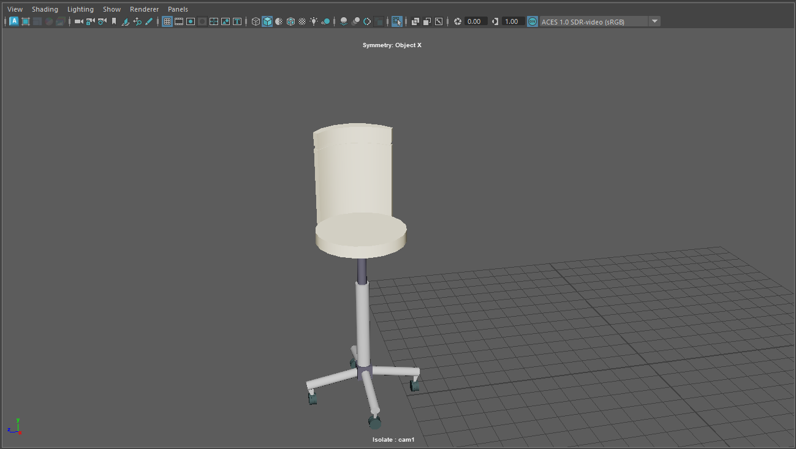
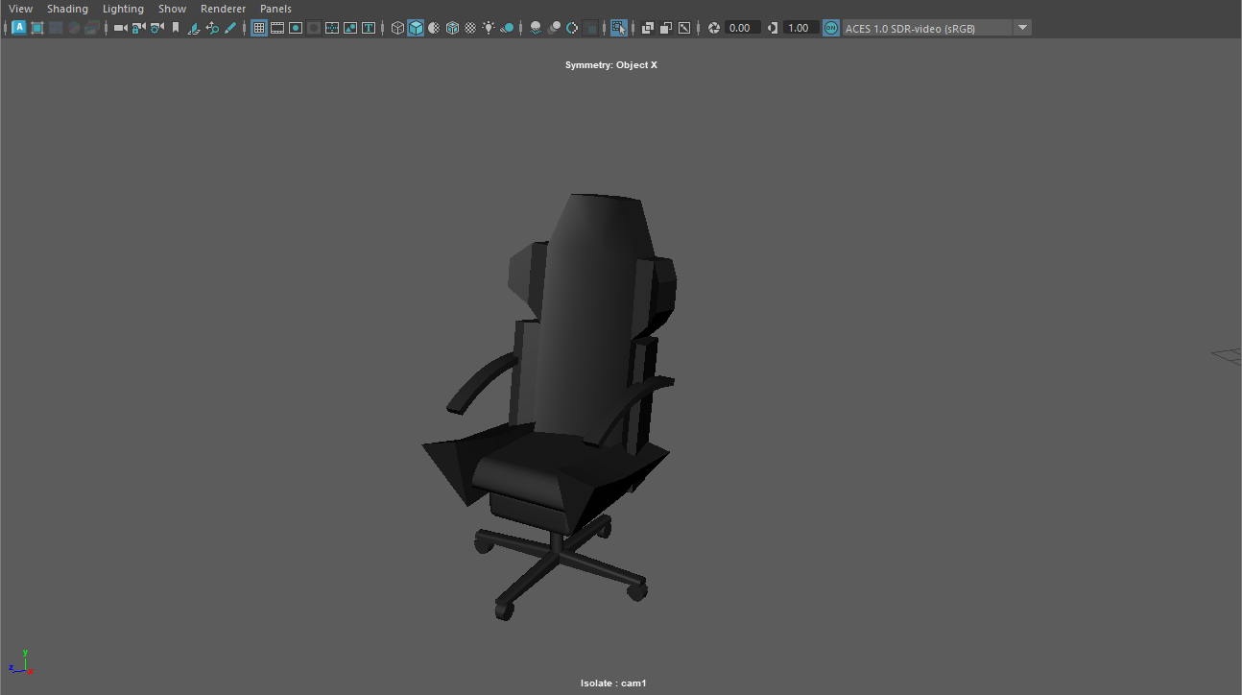
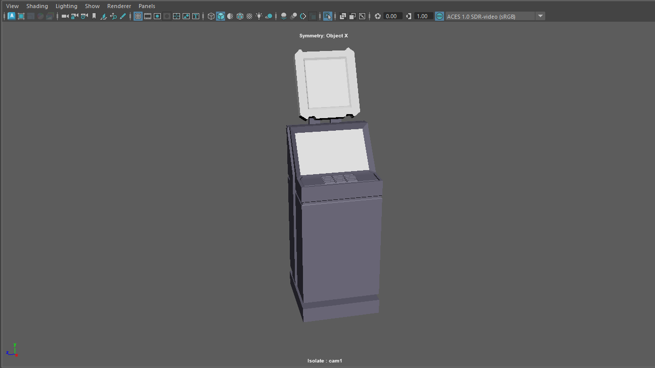
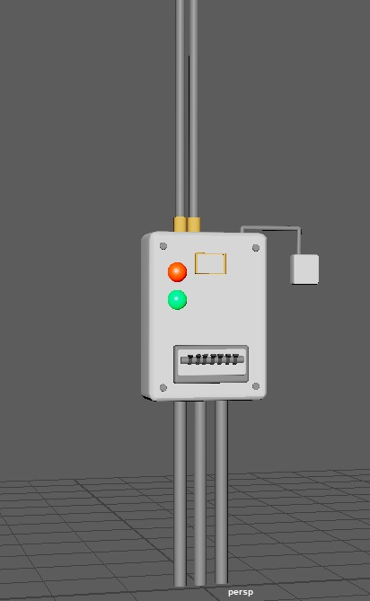

Slide 13
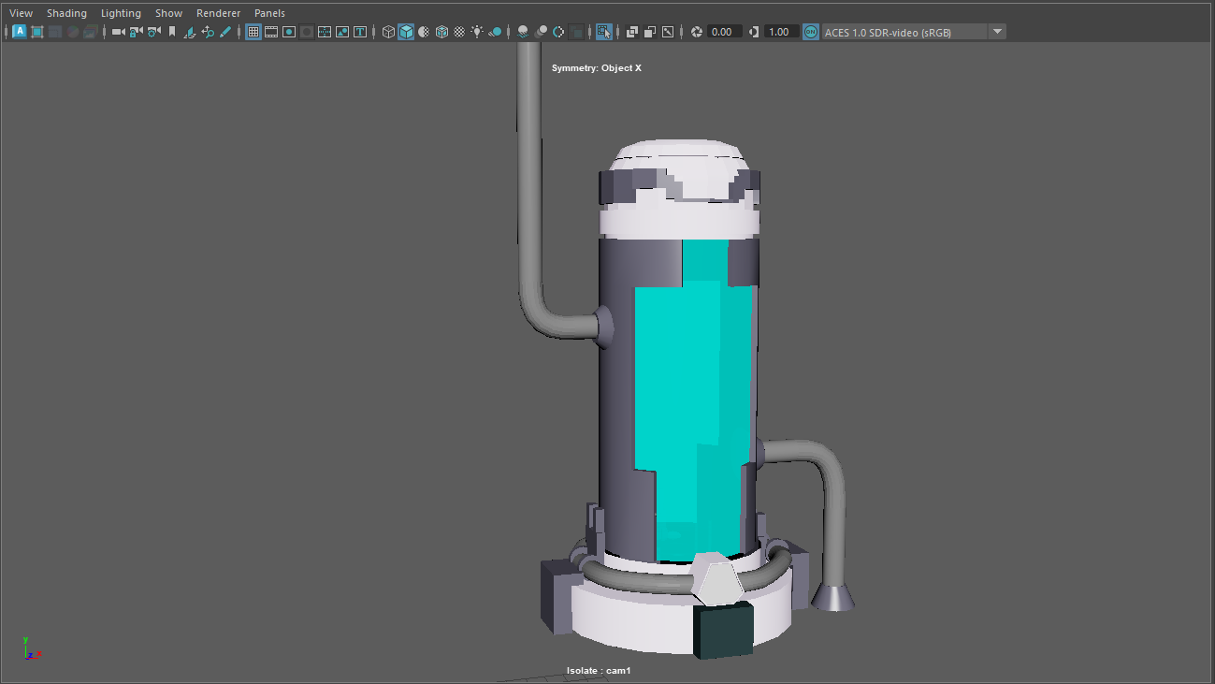
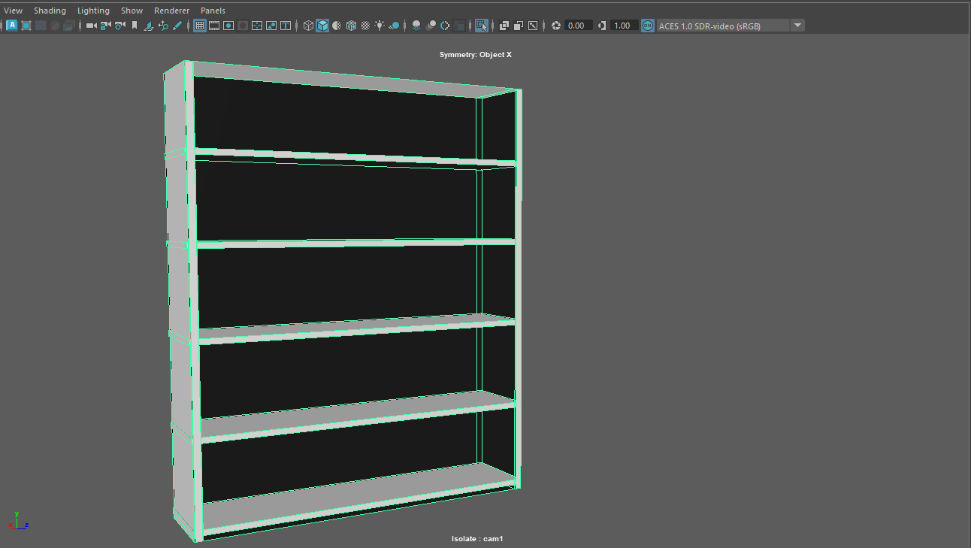
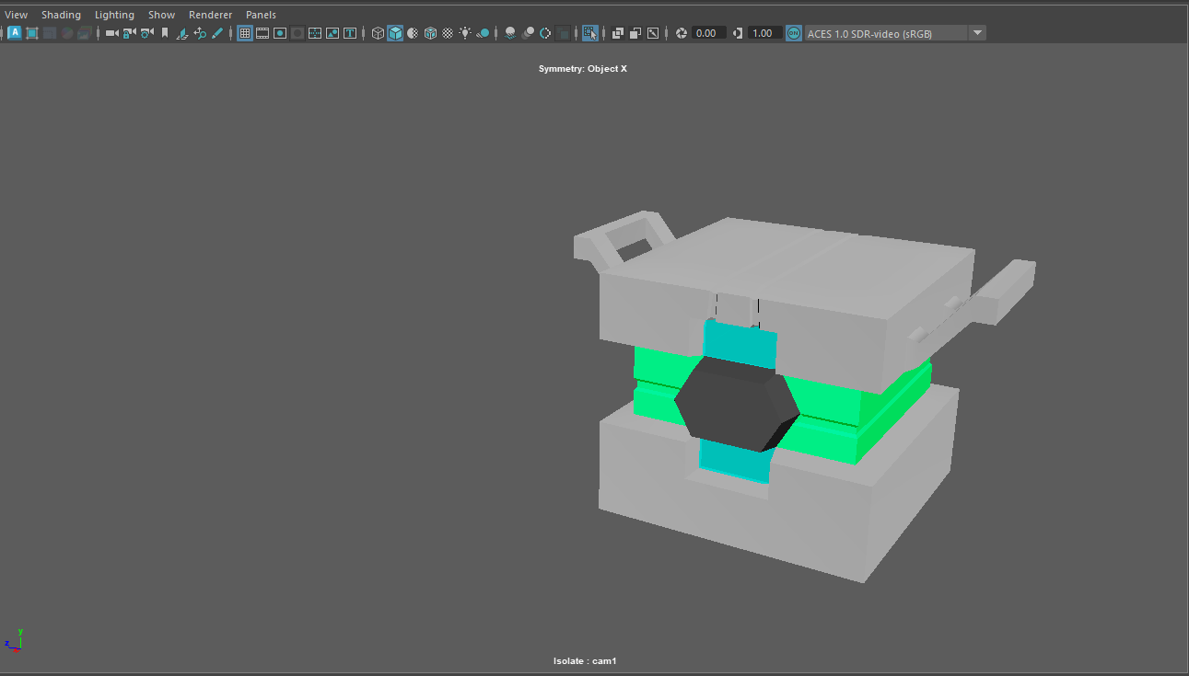

Slide 14
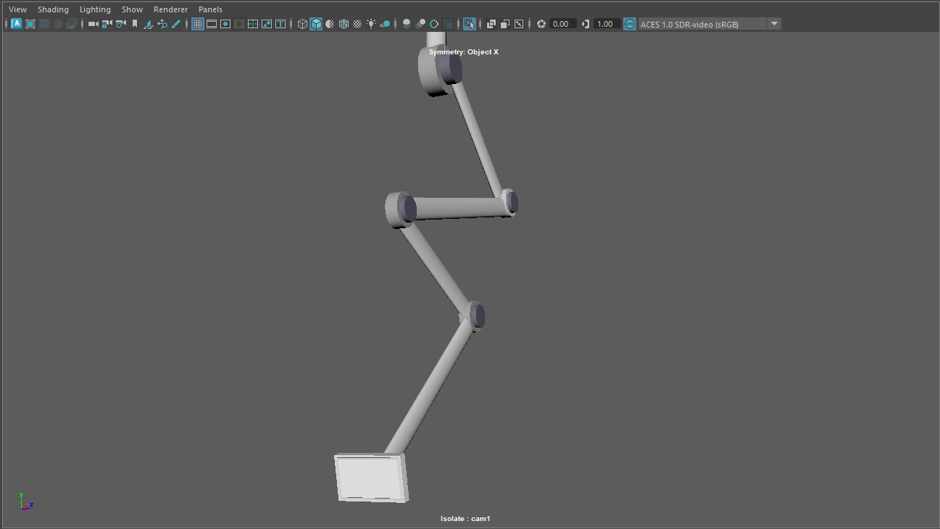
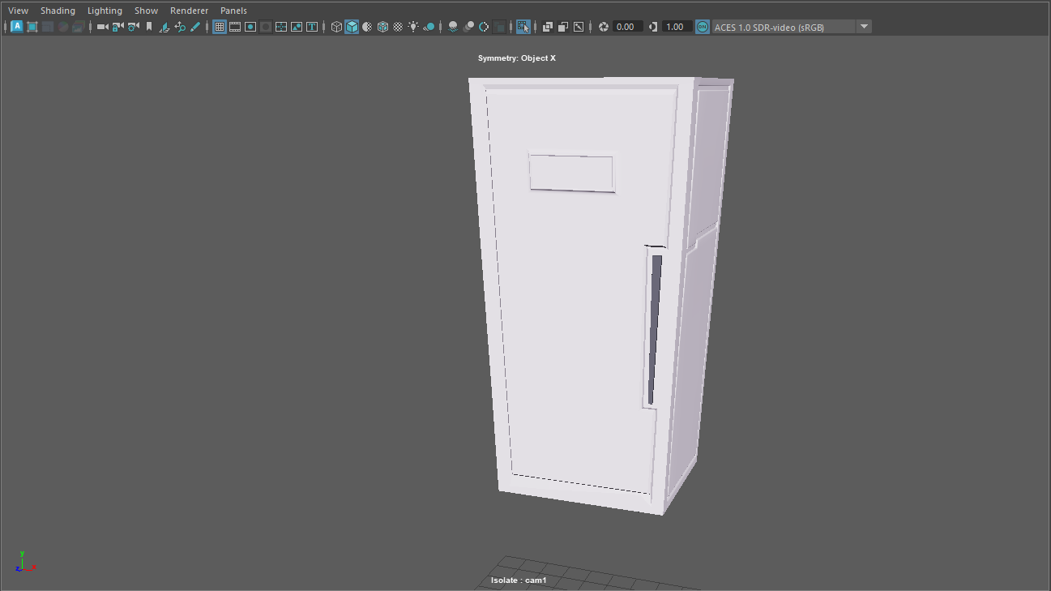
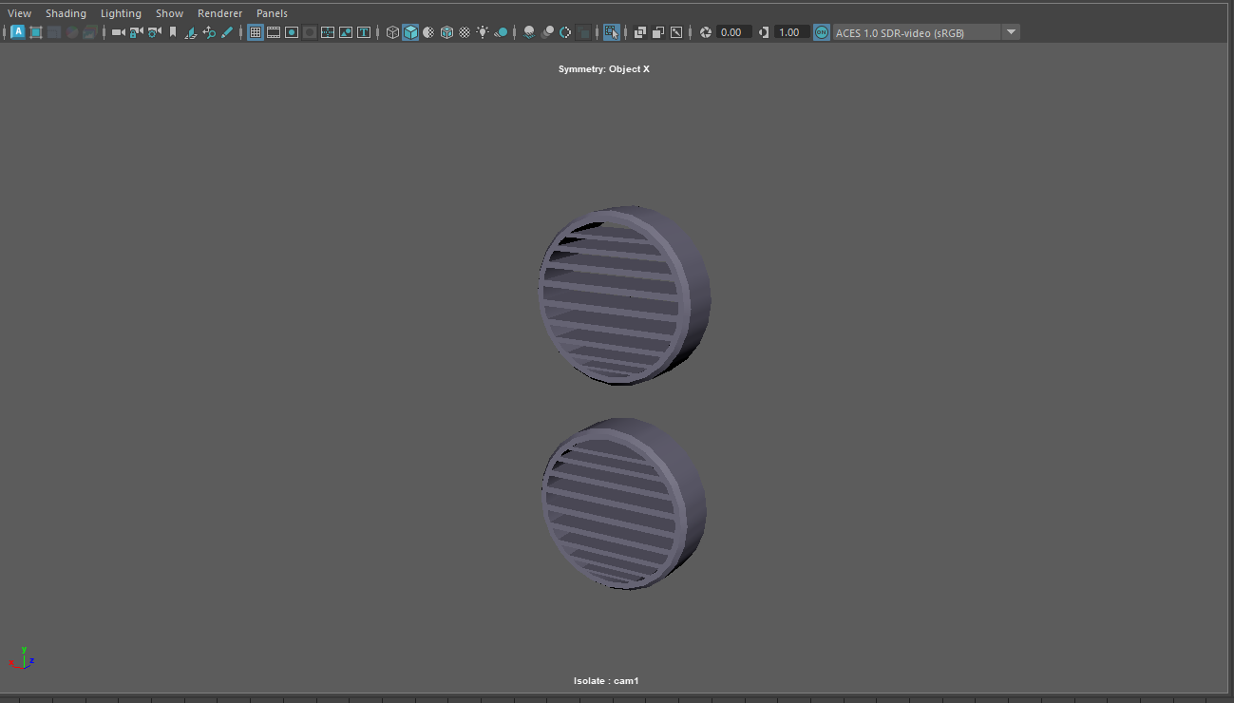

Slide 15
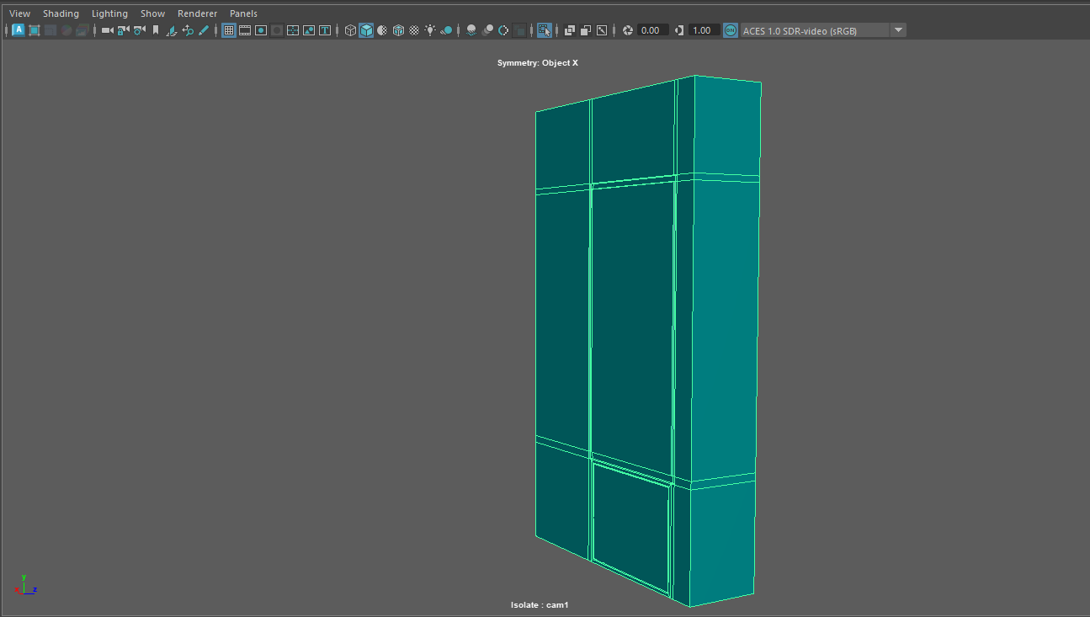
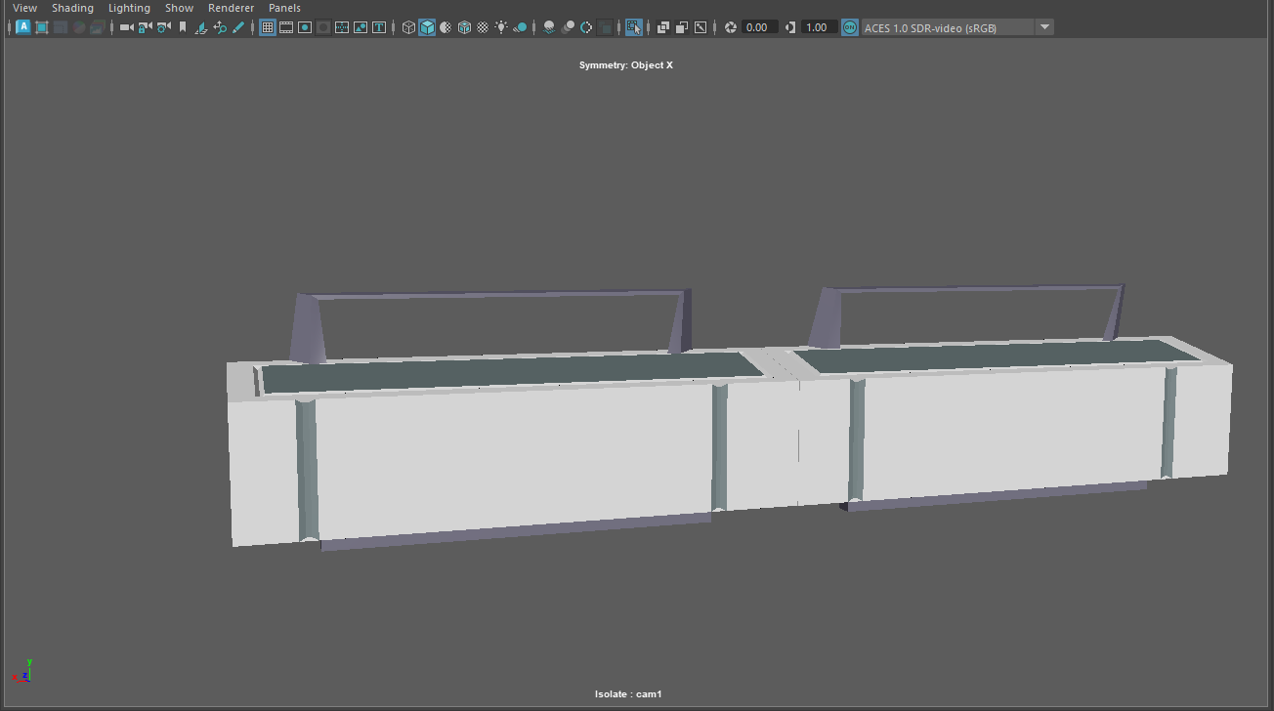

Slide 16
03
Texturing and UV unwrapping
By Martina Essam

Slide 17
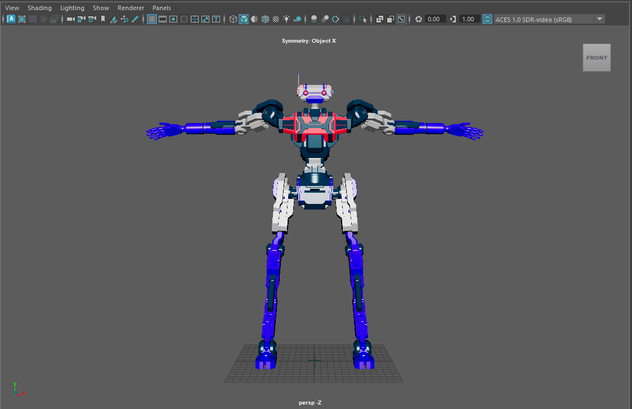
coloring

Slide 18
04
Character rigging
By Martina Essam

Slide 19
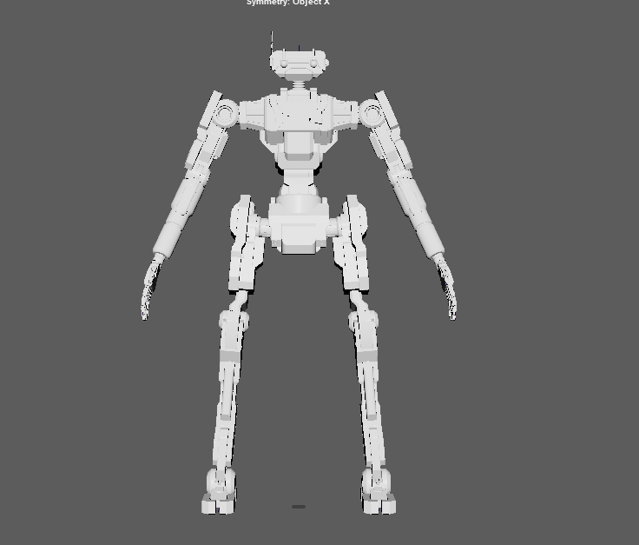
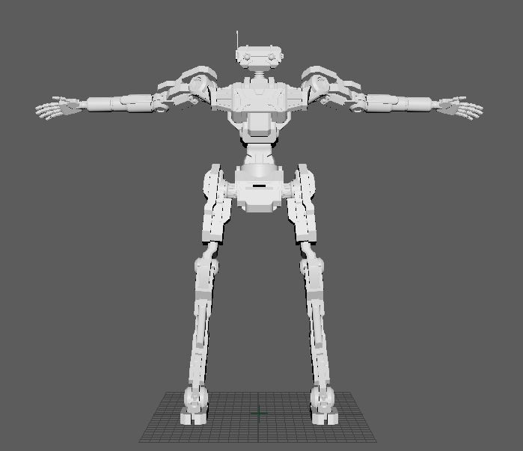
Assigning the model from A pose to T pose

Slide 20
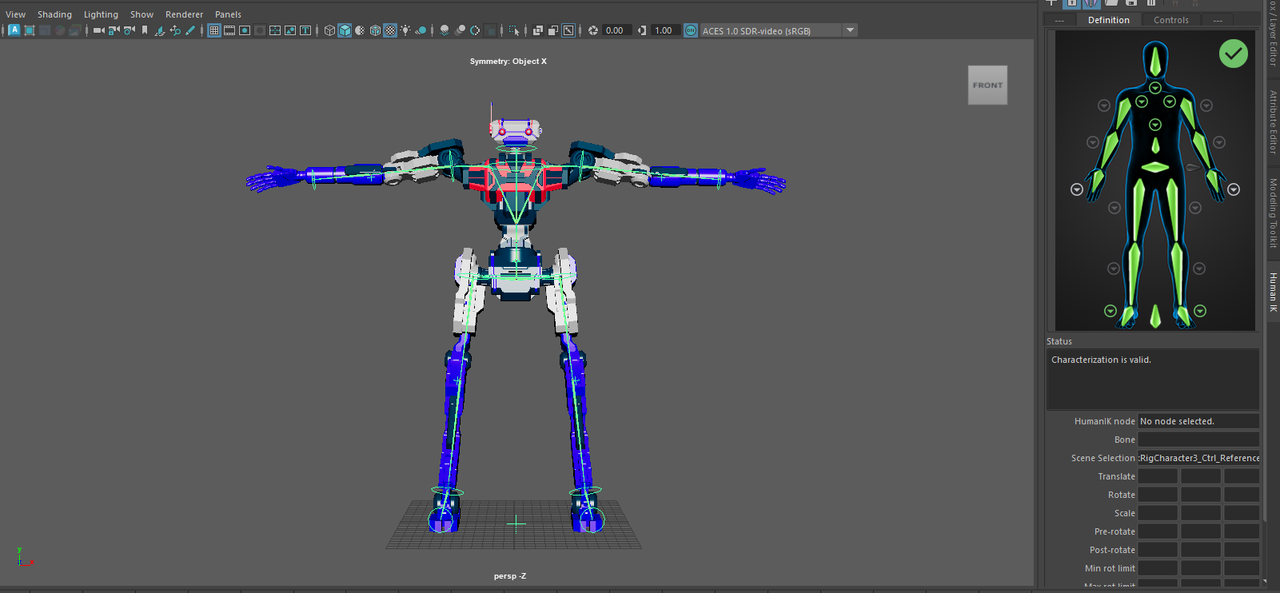

Slide 21
05
Animation

Slide 22
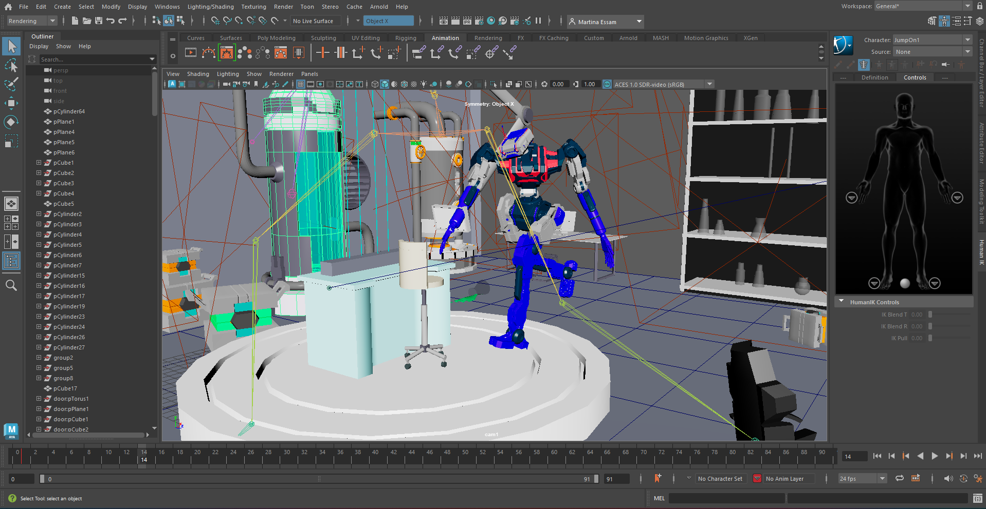
steps

Slide 23
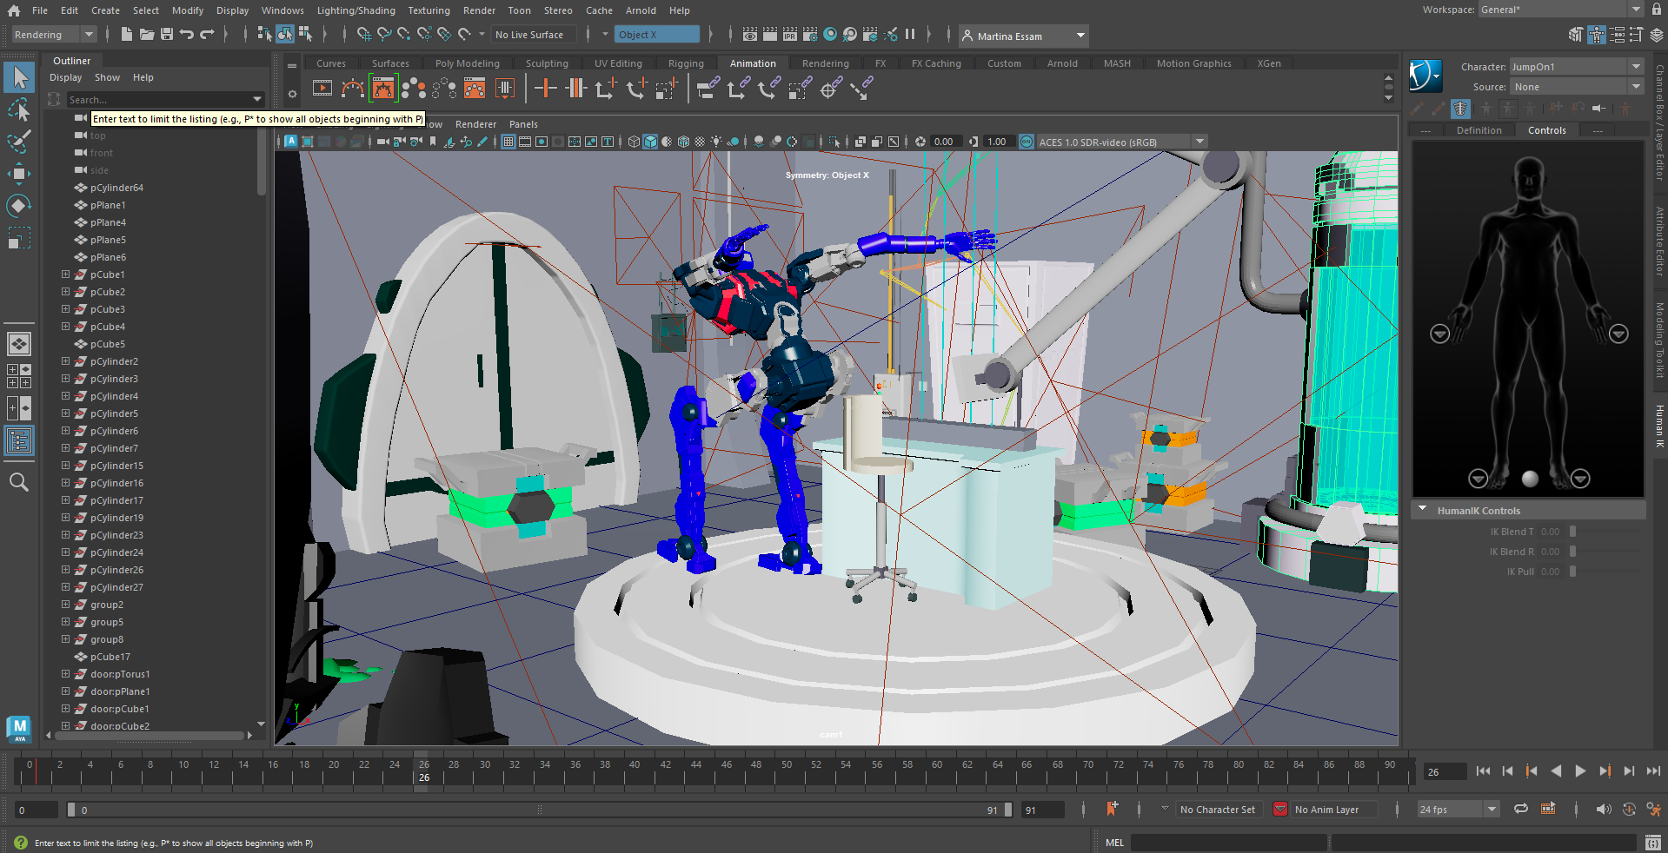

Slide 24
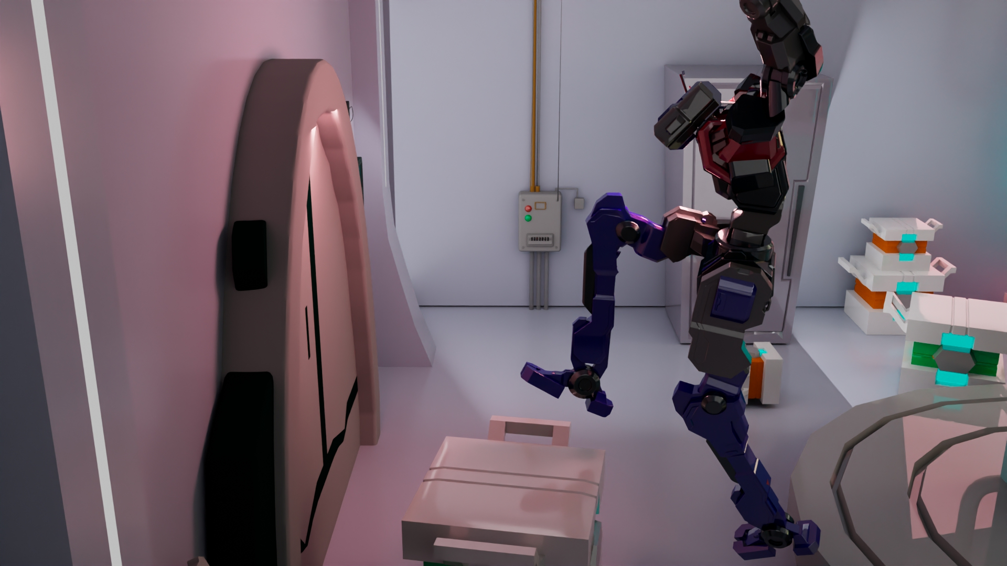
Final

Slide 25
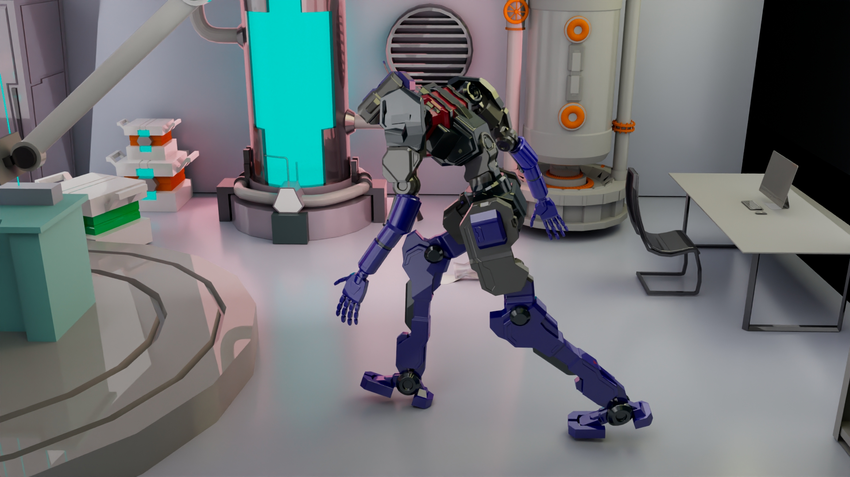
Final

Slide 26
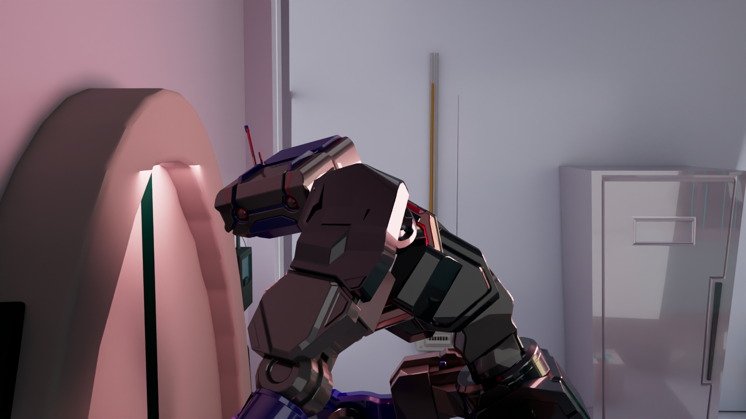
Final

Slide 27
06
Compositing and lighting

Slide 28
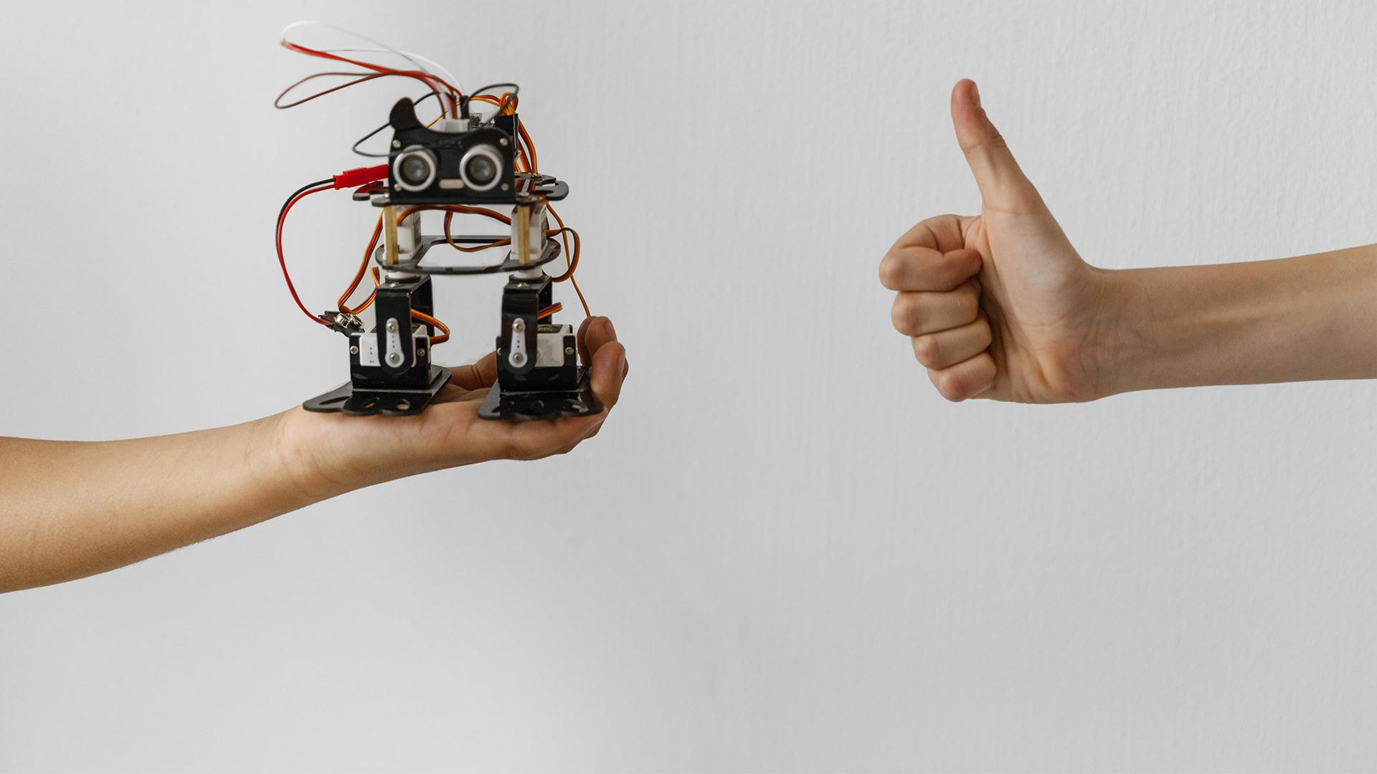
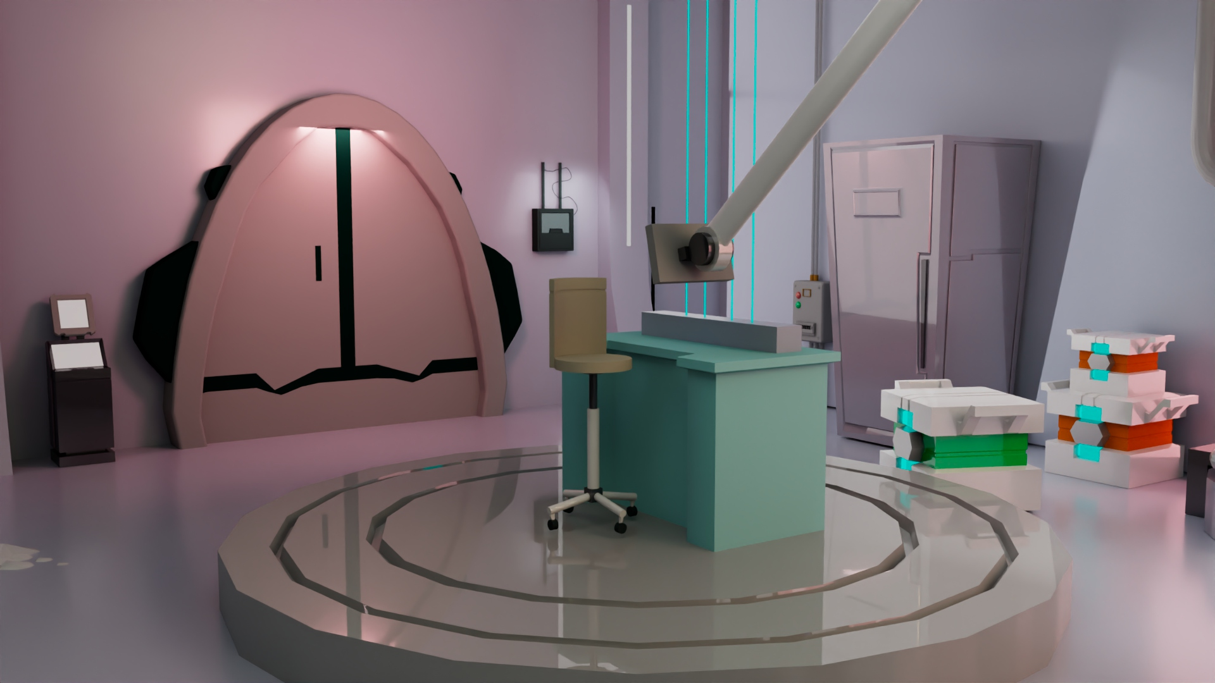
A PICTURE IS A WORTH A THOUSAND WORDS
Environment final render

Slide 29
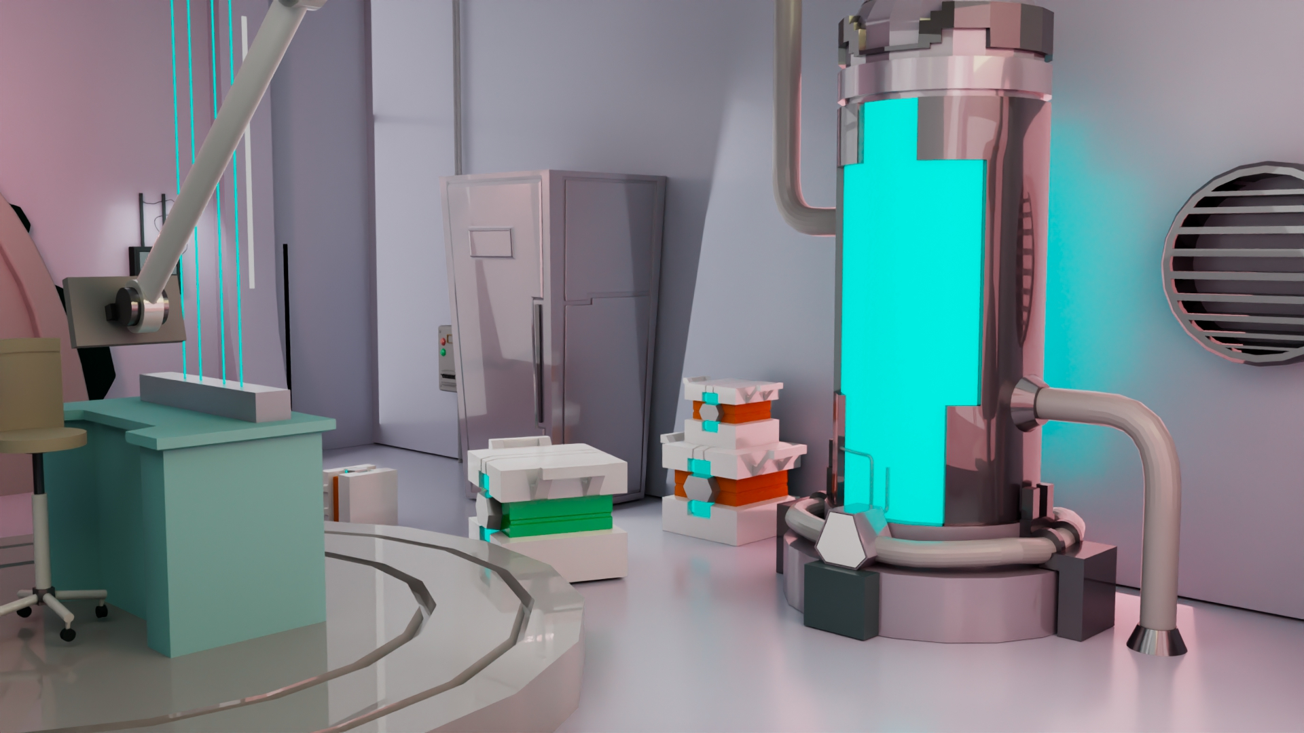
A PICTURE IS A WORTH A THOUSAND WORDS
Environment final render

Slide 30
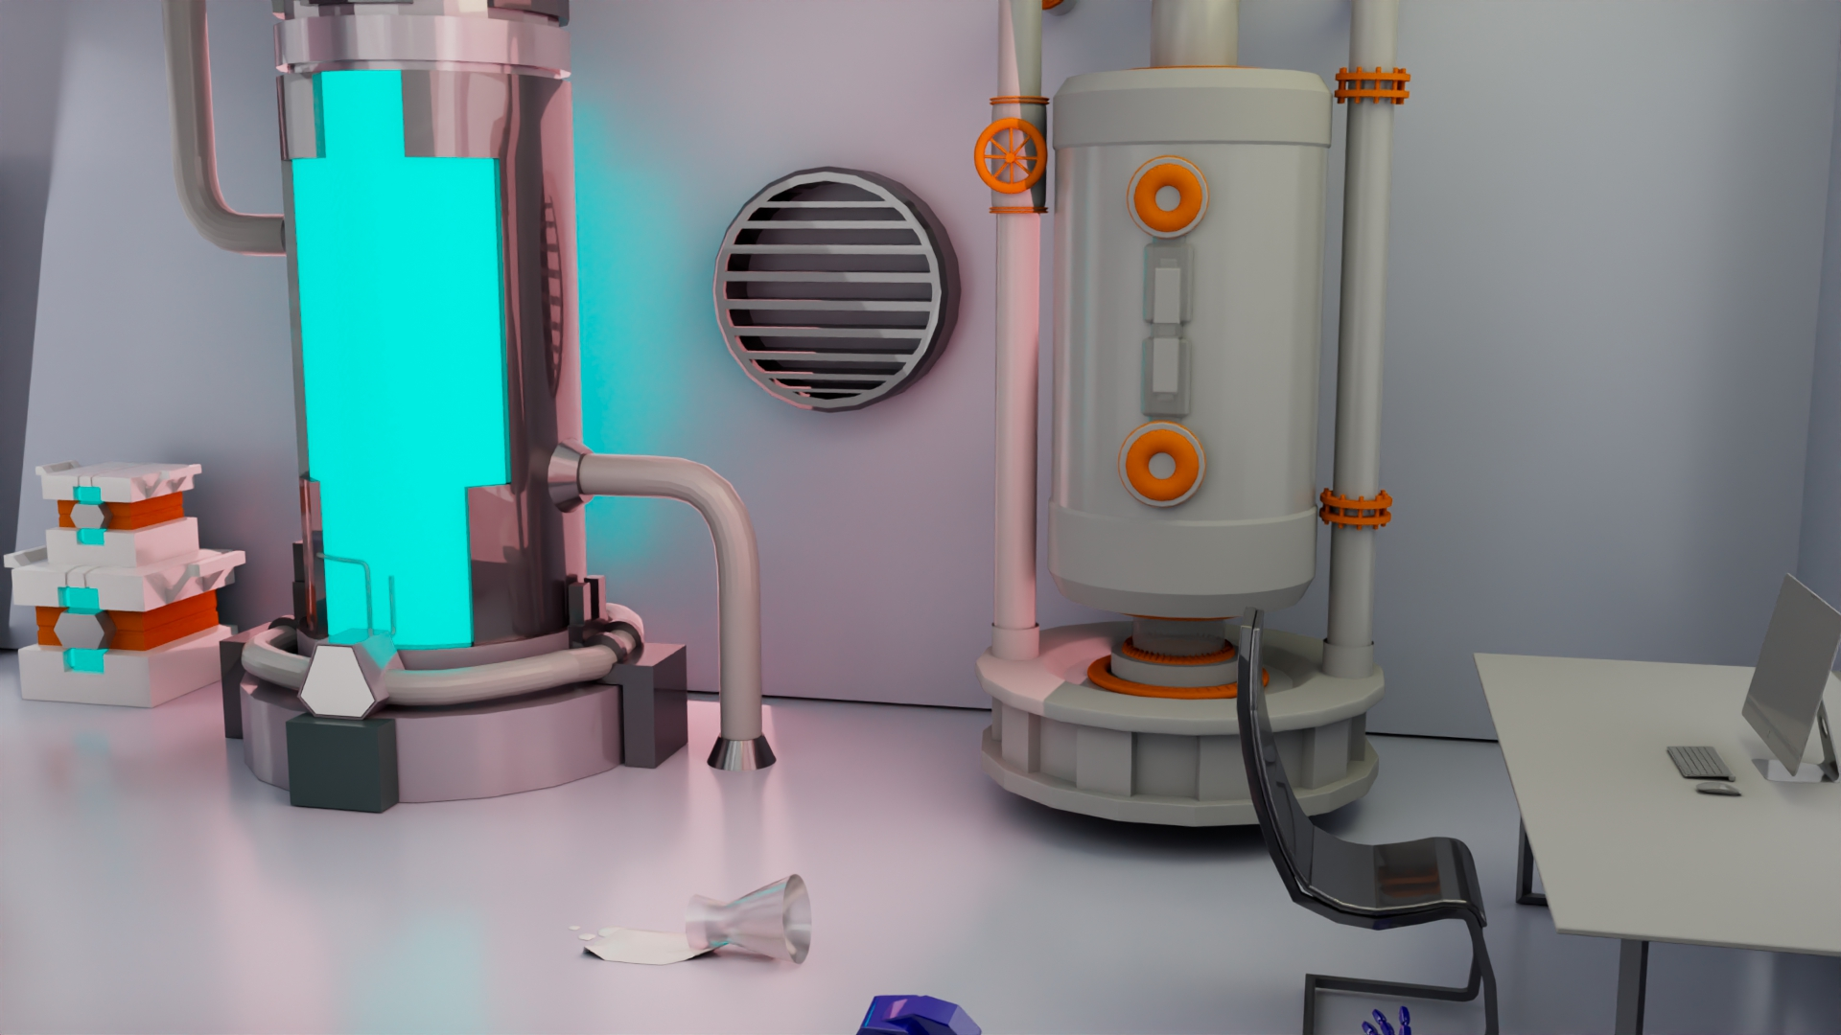
A PICTURE IS A WORTH A THOUSAND WORDS
Environment final render

Slide 31
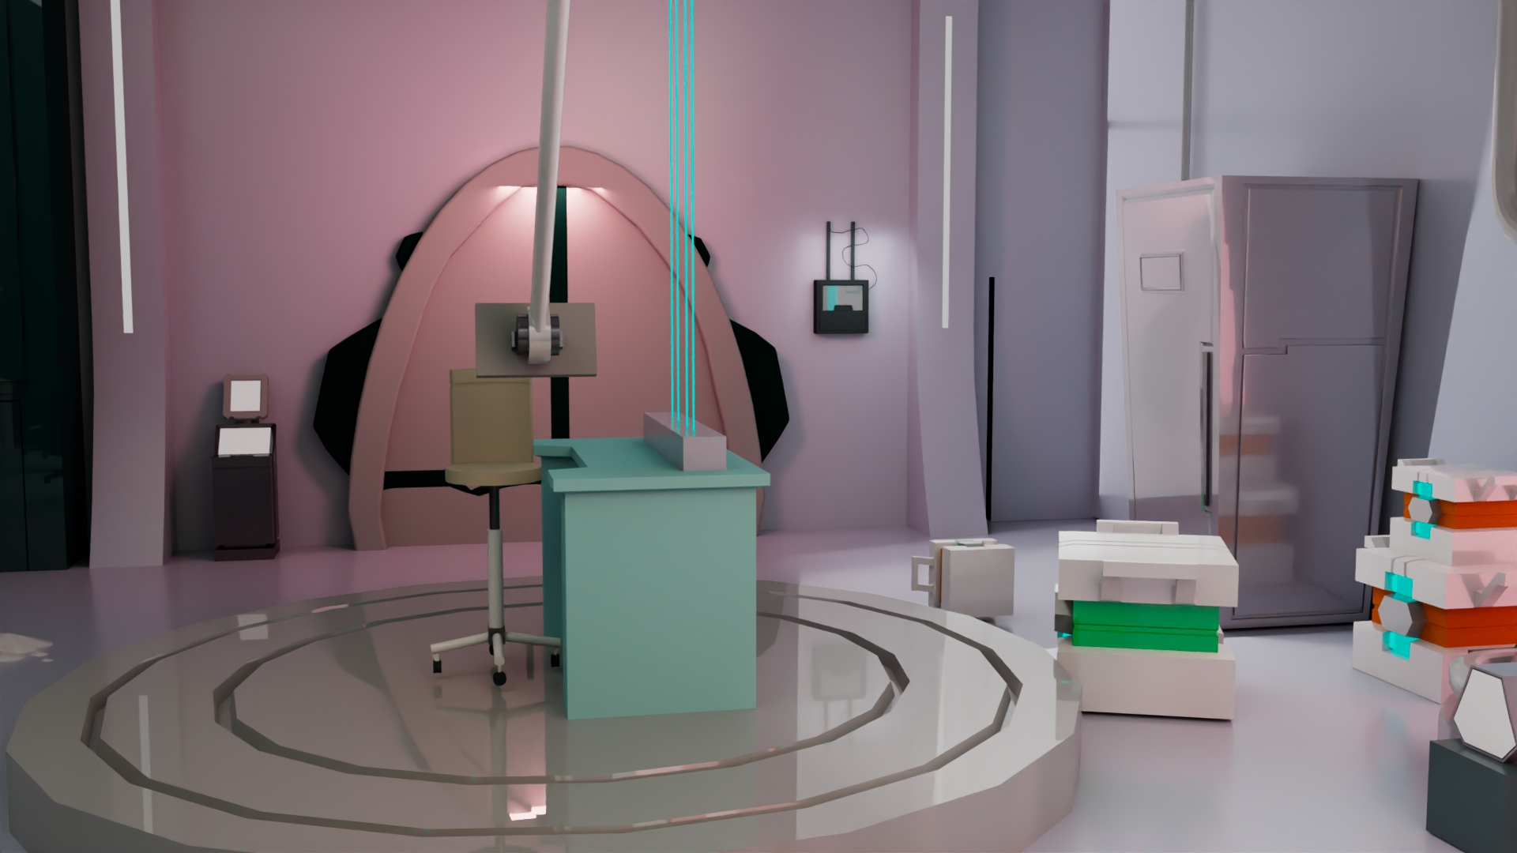
A PICTURE IS A WORTH A THOUSAND WORDS
Environment final render

Slide 32
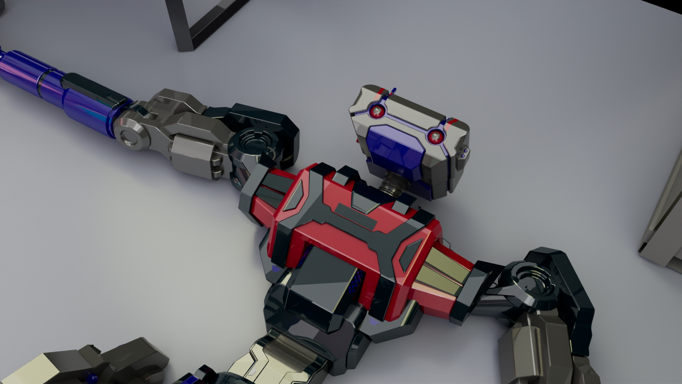
A PICTURE IS A WORTH A THOUSAND WORDS
Character final render

Slide 33
SCHEDULE
Thursday 10/10 | Friday 11/10 | Saturday 12/10 | Sunday 13/10 | Monday 14/10 | Tuesday 15/10
modelling | texturing | animation | animation | render | presentation
completed | completed | completed | completed | completed | completed
TASK 1
Modelling, texturing, rigging
TASK 2
Animation , Rendering , Final presentation

Slide 34
THANKS!
Team members :
Ashraqat Shahin
Ehab Heness
Hana Mahmoud
Martina Essam
Martina Malak
Mostafa Yasser

